Slide 1

Sovereign Debt and Financial Stability
Exploring the relationship between sovereign debt levels and financial stability.
BY
MAYUKH PAUL REGISTRATION NO – 220010026832
ENROLNMENT NO – 2211212001006
SISTER NIVEDITA UNIVERSITY
KOLKATA- 700156
→

Slide 2
INTRODUCTION
Sovereign debt is a form of public debt issued by a national government, usually in the form of bonds, to raise funds for public spending.
→
Why is it important?
Funds Essential Government Services
Supports Economic Stability
Enables Investment in Growth
Impacts Global Markets
→

Slide 3
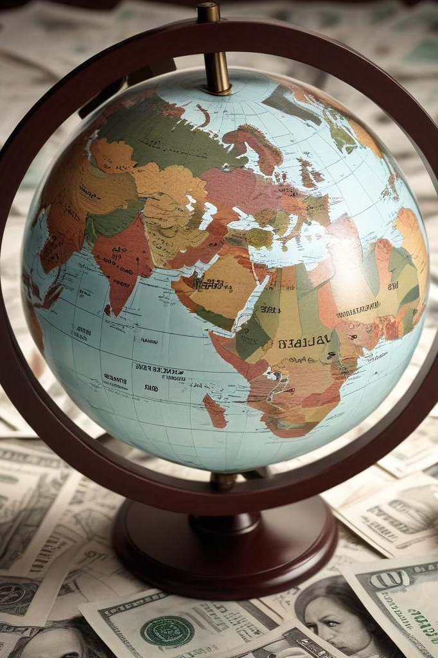
01
Understanding Sovereign Debt

Slide 4
Definition and Importance
→
A national government's borrowing of funds, usually to fund public investments or fill budget gaps, is referred to as sovereign debt.
→
It comes in two main types: Domestic debt, which is issued and repaid in the country’s own currency and sold to local investors, and
Foreign (external) debt, which is issued in foreign currencies and held by international creditors.
→
How governments borrow
- Governments usually borrow by issuing bonds—debt securities that promise to pay back the principal with interest over time. These bonds can be sold to individuals, institutions, or other countries, making sovereign debt a vital tool for managing national finances.

Slide 5
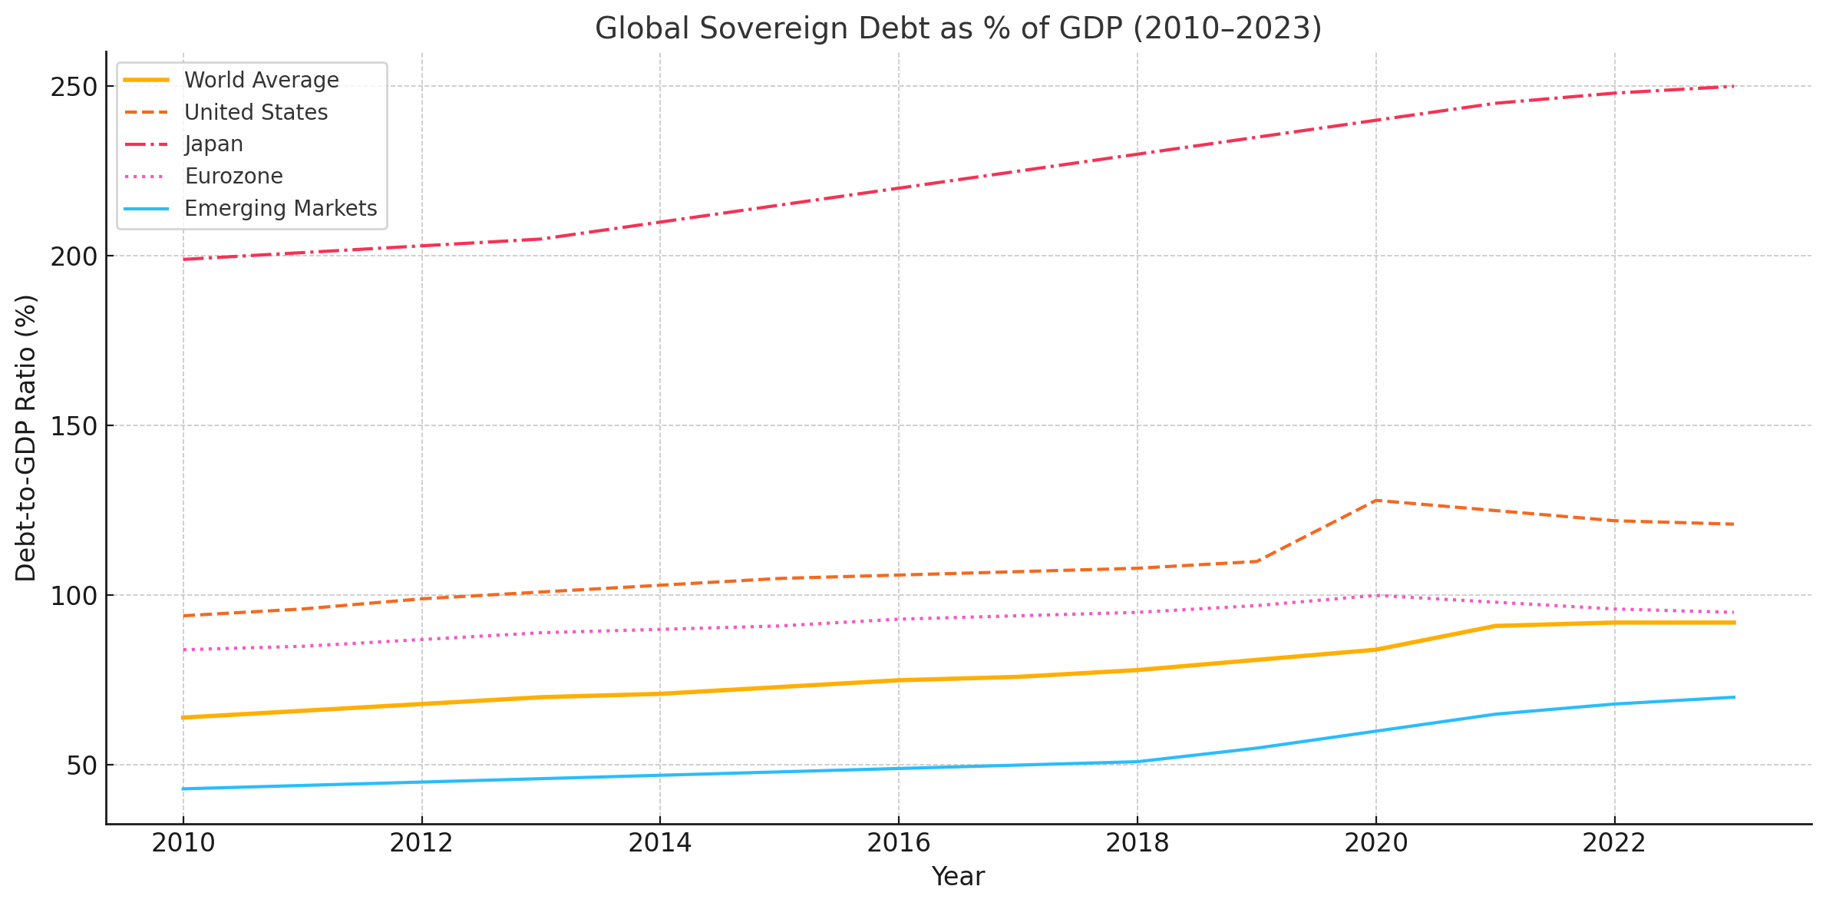
Recent Trends and Statistics
As we can see, the world average has been rising steadily, especially after 2020. This reflects the global borrowing surge during the COVID-19 pandemic
The U.S. saw a sharp increase in debt levels around 2020–2021, jumping from about 110% to over 125%, due to massive stimulus spending
Japan has consistently had the highest debt-to-GDP ratio, now around 250%, which is a result of decades of borrowing to stimulate its economy. The Eurozone shows a moderate rise and then a slight decline, thanks to fiscal tightening in some member states.
Emerging economies started with lower debt but are showing a clear upward trend, highlighting growing risks in developing countries. Overall, this graph emphasizes a global shift toward higher sovereign debt, raising concerns about financial stability, especially as interest rates rise.
↓
Source: International Monetary Fund (IMF), World Economic Outlook Database, April 2023. Retrieved from https://www.imf.org/en/Publications/WEO

Slide 6

Impact on Financial Stability
→
Positive in moderation: enables spending during downturns
Negative when excessive: • Risk of sovereign default • Spillover to banks and financial markets • Upward pressure on inflation and interest rates
→
↓

Slide 7

Case Study – The European Debt Crisis
Background: Post-2008 financial crisis triggered debt concerns in several Eurozone countries
The European Debt Crisis emerged in the aftermath of the 2008 financial crisis, exposing deep fiscal vulnerabilities in the Eurozone.
Greece became the epicenter, with revelations of misreported deficits and unsustainable debt levels. Spain and Italy were pulled in due to weak banking systems and rising debt costs.
The European Central Bank and IMF played crucial roles—offering bailouts and implementing bond-buying programs to stabilize markets.
The crisis highlighted the risks of having a shared currency like the euro without coordinated fiscal oversight. It ultimately led to reforms aimed at improving financial governance in the EU.
→

Slide 8

Conclusions
Sovereign debt is a double-edged sword — it can fuel recovery and growth, but if mismanaged, it becomes a threat to financial stability.
We've seen how key indicators like debt-to-GDP ratios, interest burdens, and bond spreads act as early warning signs.
The European Debt Crisis showed us how quickly things can spiral — but also how coordination and reform can stabilize economies.
As global debt levels rise, especially post-pandemic, the need for fiscal responsibility and proactive policy becomes more critical than ever.
“Debt is not inherently bad — it’s how you use it that makes the difference.”
↓

Slide 9
Thank you!
Do you have any questions?
www.yourwebsite.com
↓
CREDITS: This presentation template was created by Slidesgo, and includes icons, infographics & images by Freepik
+91 620 421 838

